Slide 1
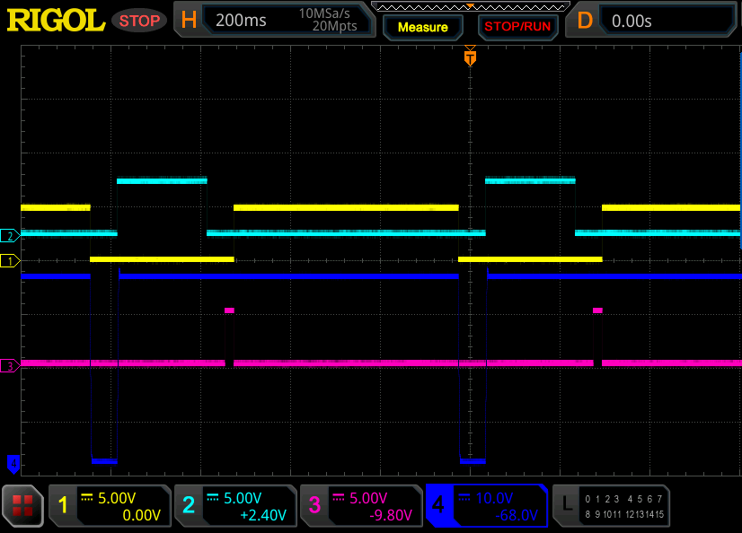
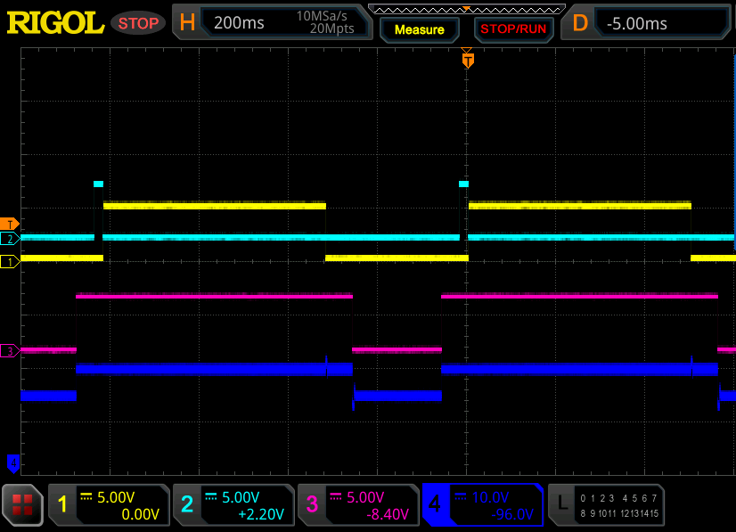
20230110
Timing Table Check after Ding’s Fixing
Fill: 200 mS Separation: 500 mS Trap: 40 mS Flush: 60 mS Release: 20 ms
(Here settings are for algorithm check rather than real application setting)
Cycle: < Fill ><Trap><Release>< Separation >< Flush >
Ent PG
Enable
Enable
LOBAR G1 SW
D grd
Ent ICD
LOBAR G2 SW
Ent SG

Slide 2
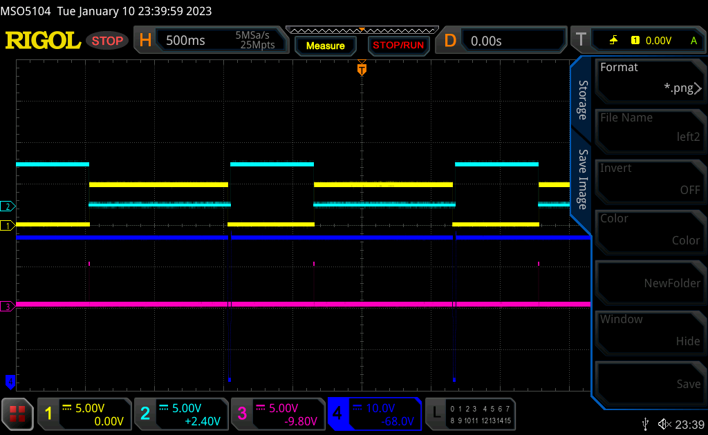
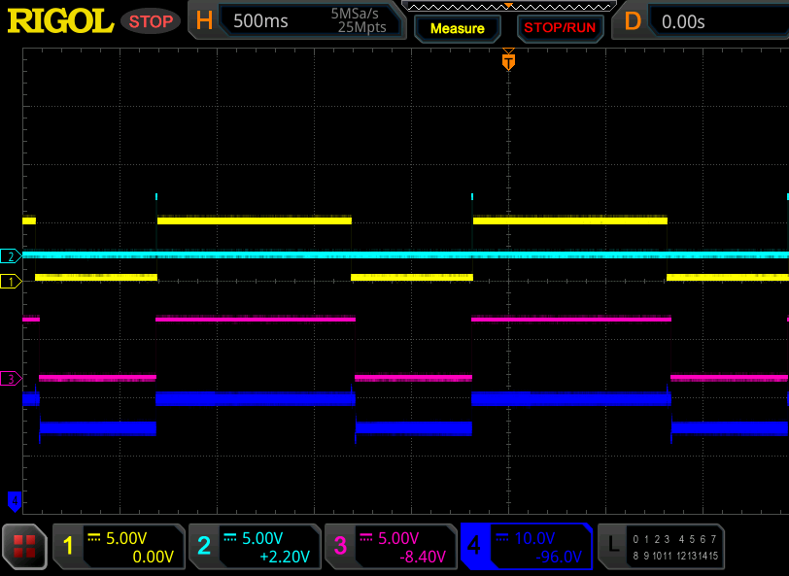
Fill: 600 mS Separation: 1000 mS Trap: 0.2 mS Flush: 20 mS Release: 5 ms
(Here settings are from one real application)
Cycle: < Fill ><Trap><Release>< Separation >< Flush >
Ent PG
Enable
Enable
LOBAR G1 SW
D grd
Ent ICD
LOBAR G2 SW
Ent SG

